Slide 1
Process mining

Slide 2
AGENDA
Data vs Process Mining
Theory and Methodology
Types of Process Mining
Models
Process Optimization
Software Tools
Exercises

Slide 3
Data mining vs process mining

Slide 4
1. Introduction to Data Mining
Definition and purpose of data mining
Data mining, also known as knowledge discovery in data (KDD), is the process of uncovering patterns and other valuable information from large data sets.
It involves using statistical algorithms, machine learning, and database systems to sift through massive amounts of data to identify useful information.

Slide 5
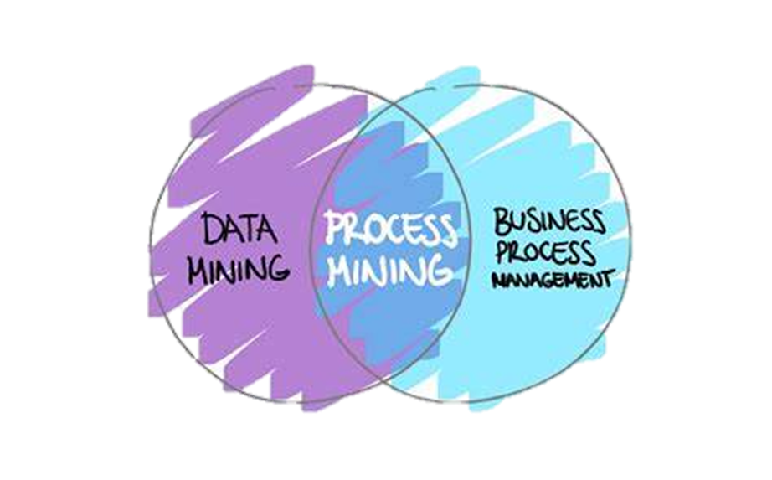
Relation to process Mining:
Process mining sits at the intersection of business process management (BPM) and data mining.
Process mining takes a more data-driven approach to BPM, which has historically been managed manually. Process mining brings a more quantitative approach to a process problem, detailing the actual process through event data.
Notes:
BPM generally collects data more informally through workshops and interviews and then uses software to document that workflow as a process map.

Slide 6
Relation to process Mining:
Dataset Scope:
Data mining is applied across various datasets, whereas process mining specifically works on event logs.
Tools and Algorithms:
Some algorithms and tools may overlap, but process mining tools are specialized to handle process-oriented data.
Domain scope:
Process mining is more oriented towards improving business process management (BPM) whereas data mining is applicable to a variety of domains.

Slide 7
THEORY AND METHODOLOGY

Slide 8
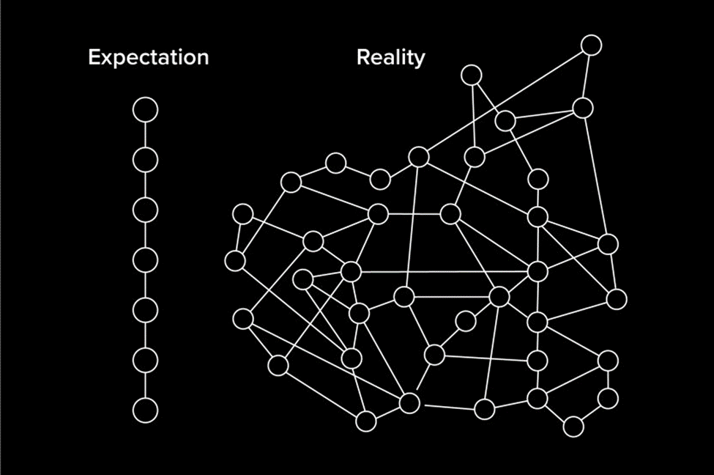
2. Process Mining: Theory and Methodology
Definition
Process mining is a technique to analyze, improve, and track processes .
Comprises a family of techniques used to analyze event data to understand and improve operational processes..
Rather than manage business processes manually by observation, meetings, or interviews as is done in business process management, we adopt a data driven approach.

Slide 9
2. Process Mining: Theory and Methodology
Relevant Questions Answered
Where are the bottlenecks in the process?
What is causing some cases to run late?
Which resources are overloaded?
Which activities are skipped most often?
Which resources create deviations?

Slide 10
benefits to consider
Enhanced transparency: Process mining offers a data-driven view of operational processes, surpassing traditional business process mapping. This deep visibility is crucial for identifying inefficiencies and compliance issues and understanding the actual process flow.
Data-driven decision making: Process mining facilitates objective decisions using IT systems data.
Process optimization: By continuously monitoring process performance metrics, such as KPIs and SLAs, process mining identifies opportunities for optimization and automation across various operations.

Slide 11
benefits to consider
Customer-centric process view: It offers detailed insights into customer journeys by aligning external customer interactions with internal operations, highlighting areas for improvement in customer experience.
Process standardization: It supports standardizing processes across an organization by identifying variations and aligning them with the optimal process model. This helps ensure consistent performance and quality.
Better customer experience: Streamlining processes and enhancing efficiency leads to improved service delivery, fostering greater customer satisfaction and loyalty.

Slide 12
Challenges to consider
Since process mining is still a relatively new discipline, it still has some hurdles to overcome. Some of those challenges include:
Data quality: Finding, merging, and cleaning data is usually required to enable process mining. Data might be distributed over various data sources. It can also be incomplete or contain different labels or levels of granularity. Accounting for these differences will be important to the information that a process model yields.
Concept drift: Sometimes processes change as they are being analyzed, resulting in concept drift.

Slide 13
Challenges to consider
Inability to capture tasks: Process mining may miss manual tasks outside IT systems that are not recorded in event logs, limiting its scope in workflow optimizations. By integrating task mining with process mining organizations can address this gap and enhance the analysis of workflows and task-level optimizations.
Integration hurdles: Some IT systems pose integration challenges with process mining due to the lack of connectors or data format issues. Pre-packaged solutions designed for specific systems or processes can simplify integration, making the process more seamless.

Slide 14
Value proposition summary
Process mining solves the problem of not understanding how your business processes actually run, and, correspondingly, being unable to leverage them to drive greater value.
It provides companies with the insights needed to visualize how processes actually run across systems, departments, and programs, so they can understand where opportunities lie, uncover which opportunities could have the biggest impact, decide what actions to take, and measure the value they generate.

Slide 15

Process Mining Application
Process mining techniques are widely used in industries such as manufacturing, healthcare, and finance.
Helps organizations to discover, monitor, and improve real processes by extracting knowledge from event logs.
Can be used to optimize costs, reduce risks, and increase customer satisfaction.
Notes:
Process mining is used to analyze complex processes in various industries. Its application helps companies to understand their processes better, identify inefficiencies and bottlenecks, and improve their overall performance. With process mining, businesses can make data-driven decisions and achieve better outcomes.

Slide 16
2. Process Mining: Theory and Methodology
1. Data Acquisition
2. Preprocessing
4. Conformance Checking
Comparison with existing models
Identify deviations
Analyze conformance
Metrics calculation
5. Enhancement
Performance Analysis
Resource Analysis
Variant Analysis
Improve
Monitor and Refine
Identify Data Sources
Data Cleaning
Data Filtering
Data Enrichment
3. Process Discovery:.
Extract event logs
Integrate different data sources.
Apply Discovery Algorithms
Visualize Process Models
Validate Models

Slide 17

2. Process Mining: Theory and Methodology
Methodology overview
1. Data Acquisition:
Identify Data Sources: Determine the systems and applications that generate event logs, such as ERP, CRM, BPM systems, and other relevant data sources.
Extract Event Logs: Collect event logs from these systems, ensuring that the logs include essential attributes such as timestamps, activities, resources, and case IDs.
Data Integration: Combine logs from multiple sources if necessary, ensuring consistency and completeness.

Slide 18
2. Process mining: THEORY AND METHODOLOGY
Sources of Event Log Data
Enterprise Resource Planning (ERP) Systems: Systems like SAP, Oracle, and Microsoft Dynamics
Customer Relationship Management (CRM) Systems: Systems like Salesforce and HubSpot track customer interactions and sales processes.
Business Process Management (BPM) Systems: BPM software like Appian, IBM BPM, and Pega
Workflow Management Systems: Systems such as Asana, Jira, and Trello, provide event logs that track task progress and completion.
Transaction Logs: Logs from e-commerce platforms, banking systems, and other transactional systems capture detailed sequences of transactional events.
Application and Web Server Logs: Logs from web servers (e.g., Apache, Nginx) and application servers (e.g., Tomcat, WebSphere) record user interactions and system events.
IoT Devices: Internet of Things devices generate logs capturing real-time data about physical processes..

Slide 19
2. Process Mining: Theory and Methodology
Types of Event Data
Timestamp: The exact time an event occurred, crucial for understanding the sequence and timing of process steps.
Activity: The specific action or task performed.
Resource: The person or system responsible for performing the activity, which helps identify roles and responsibilities in the process.
Case ID: A unique identifier for each process instance, allowing for the tracking and analysis of individual process flows.
Additional Attributes: Other relevant data such as location, cost, duration, and any other context-specific information that may be valuable for analysis.

Slide 20
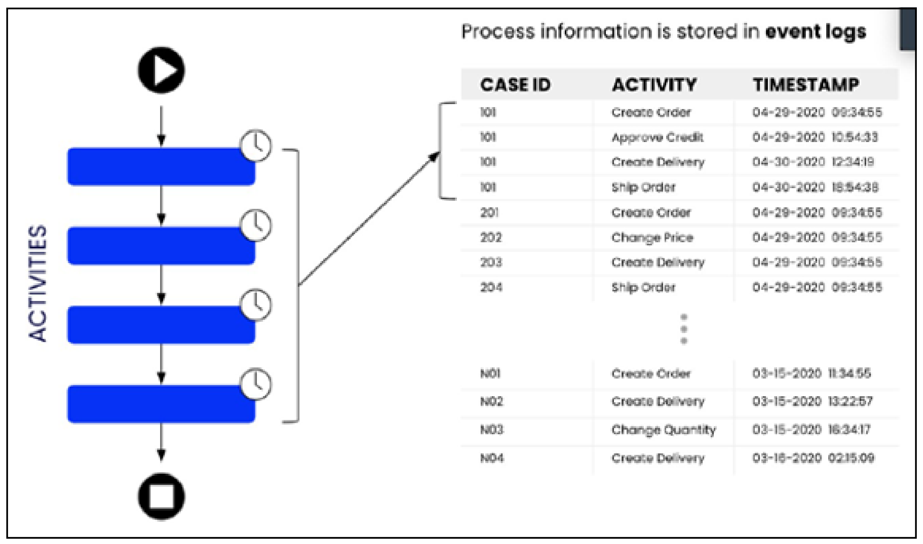
Sample log
Event data is stored in logs

Slide 21

2. Process Mining: Theory and Methodology
Preprocessing
These preprocessing steps ensure that the event data is accurate, relevant, and enriched with additional information, enabling effective process mining analysis.

Slide 22


2. Process Mining: Theory and Methodology
Cleaning
Removing Duplicates: Ensuring that each event is unique and not repeated, which can distort analysis.
Handling Missing Values: Addressing incomplete data entries by either imputing missing values or removing incomplete records.
Correcting Errors: Fixing inaccuracies in the data, such as incorrect timestamps or misspelled activity names.
Standardizing Formats: Ensuring consistency in data formats, such as date and time formats, to facilitate analysis.

Slide 23

2. Process Mining: Theory and Methodology
Filtering
Select Relevant Events: Filter out irrelevant events to focus on the pertinent process data.
Define Time Frames: Limit the analysis to a specific period by selecting events within a defined time range.
Case Selection: Filter cases based on certain criteria, such as specific process variants or performance thresholds.

Slide 24

3. Data Acquisition for Process Mining
Enrichment
Adding Contextual Data: Integrating additional data sources to provide more context to the events, such as customer information or external environmental factors.
Calculating Derived Attributes: Creating new attributes from existing data, such as calculating the duration of each activity or the time between events.
Annotating Data: Adding labels or tags to events to facilitate later analysis, such as categorizing events based on their importance or type.

Slide 25
TYPES OF PROCESS MINING

Slide 26

3. TYPES OF PROCESS Mining
Process Discovery
Definition: Process discovery is the technique of automatically generating a process model from event logs without any prior knowledge of the process.
Purpose: The goal is to uncover the actual process flow and compare it to the designed or expected process to identify discrepancies.

Slide 27
3. TYPES OF PROCESS Mining
Process Discovery Methods
Alpha Algorithm: A simple and basic algorithm that constructs a process model based on causal dependencies between activities.
Heuristic Miner: An advanced algorithm that deals with noise and exceptions by focusing on the most frequent paths.
Fuzzy Miner: Provides a flexible approach by emphasizing the main process paths while allowing for the presence of less frequent behavior.

Slide 28

3. TYPES OF PROCESS Mining
Conformance checking
Definition: Involves comparing an existing process model with an event log of the same process to check if the reality, as recorded in the log, conforms to the model.
Purpose: This technique is used to detect deviations, measure compliance, and improve process models by identifying and understanding the differences.

Slide 29
3. TYPES OF PROCESS Mining
Conformance checking methods
Token-based Replay: Simulates the process model using event log data to identify where deviations occur.
Alignments: Creates a step-by-step alignment between the event log and the process model to pinpoint exact deviations.
Fitness, Precision, Generalization, and Simplicity Metrics: Evaluate how well the process model represents the actual process, including its accuracy, overfitting, underfitting, and complexity.

Slide 30

3. TYPES OF PROCESS Mining
Enhancement
Definition: Enhancement, also known as process extension or process improvement, uses event logs to extend or improve an existing process model.
Purpose: The objective is to enhance the process model with additional perspectives, such as performance, compliance, or resource utilization, to make it more comprehensive and useful.

Slide 31
3. TYPES OF PROCESS Mining
Enhancement methods
Performance Analysis: Enhances the model by adding performance-related information, such as processing times, bottlenecks, and throughput.
Resource Analysis: Enriches the process model with information about resource utilization, workload distribution, and collaboration patterns.
Variant Analysis: Examines different variants of the process to understand variations and their impact on performance and outcomes.

Slide 32

3. TYPES OF PROCESS Mining
Predictive Process Mining
Definition: Predictive process mining uses historical event data to predict future process behavior and outcomes.
Purpose: The goal is to forecast potential issues, such as delays or failures, and provide actionable insights for proactive decision-making.

Slide 33
3. TYPES OF PROCESS Mining
Predictive Process Mining Methods:
Machine Learning Models: Utilizes algorithms like decision trees, neural networks, and regression models to predict future events and outcomes.
Predictive Analytics: Combines statistical techniques with machine learning to anticipate process performance and recommend corrective actions.

Slide 34

3. TYPES OF PROCESS Mining
Social Network Analysis
Definition: Social network analysis in process mining examines the interactions and relationships between different resources (e.g., employees, departments) involved in the process.
Purpose: To understand collaboration patterns, identify key influencers, and optimize resource allocation.

Slide 35
3. TYPES OF PROCESS Mining
Social Network Methods:
Hand-over of Work: Analyzes how work is passed between resources.
Subcontracting: Identifies which resources frequently work together.
Working Together: Looks at resources that are often involved in the same activities simultaneously.

Slide 36
models

Slide 37
4. Models in Process Mining
Petri Nets
Definition: Petri nets are a mathematical modeling language used for the description of distributed systems. They consist of places, transitions, and tokens.
Components
Places: Represent states or conditions (circles).
Transitions: Represent events that may change the state (squares).
Tokens: Represent the presence of a resource or a condition being met (black dots).
Usage: Petri nets are used to model and analyze the flow of information or resources in a system. They are well-suited for representing concurrent processes and identifying potential deadlocks or conflicts.

Slide 38
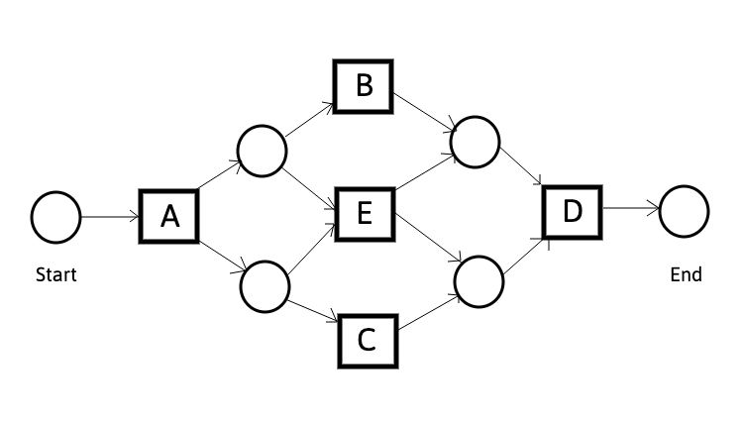
Sample petri net
Notes:
States in Petri nets are called markings that mark certain places (represented by circles) with tokens (represented by black dots). Transitions (represented by squares) are the active components able to move the Petri net from one marking to another marking. Transitions may have a label referring to the corresponding activity. There may be multiple transitions that refer to the same activity and there may be transitions without an activity label. The former is needed if the same activity can occur at multiple stages in the process. The latter is needed if activities can be skipped

Slide 39
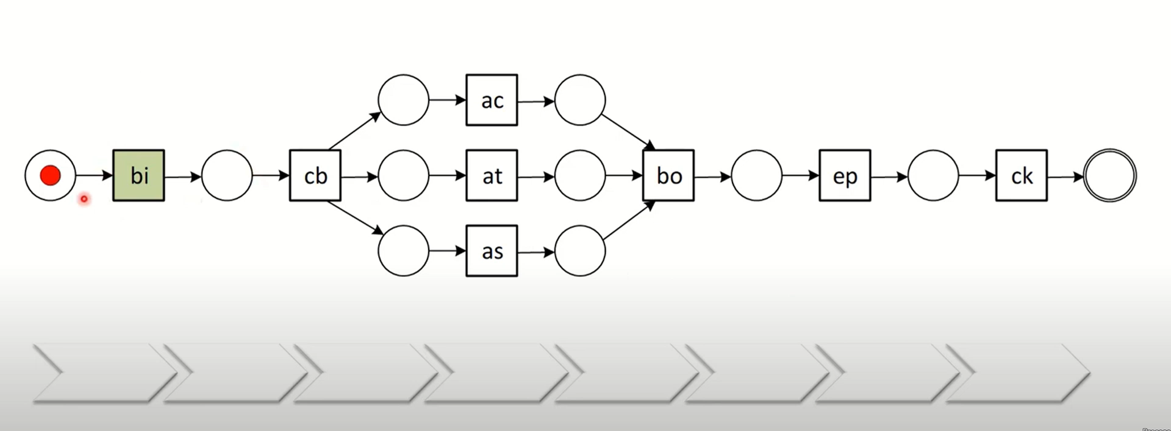
Petri net animation
Notes:
https://youtu.be/DT4YiX6FSEY?list=PL6cvdWYqrKSInrVtwwkbkhws2k-yoyYIU&t=1806

Slide 40
4. Models in Process Mining
Business Process Model and Notation (BPMN)
Definition: BPMN is a graphical representation for specifying business processes in a business process model. It provides a standard way to visualize the steps of a business process.
Components:
Flow Objects: Include events (circles), activities (rectangles), and gateways (diamonds) that control the divergence and convergence of the flow.
Connecting Objects: Arrows that show the flow between flow objects.
Swimlanes: Represent participants in the process, such as departments or roles, using pools and lanes.

Slide 41
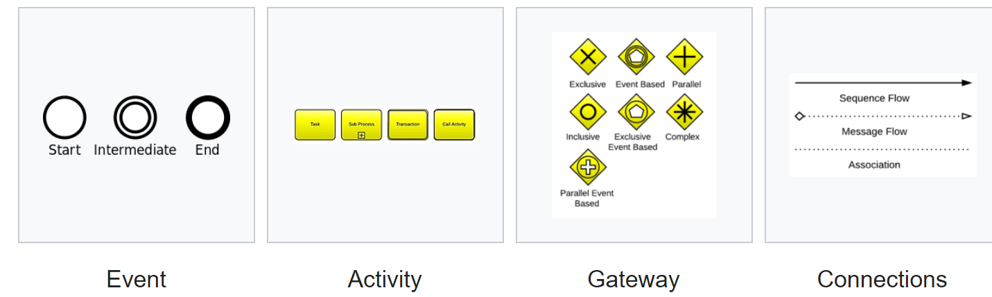
4. Models in Process Mining
Flow Objects

Slide 42
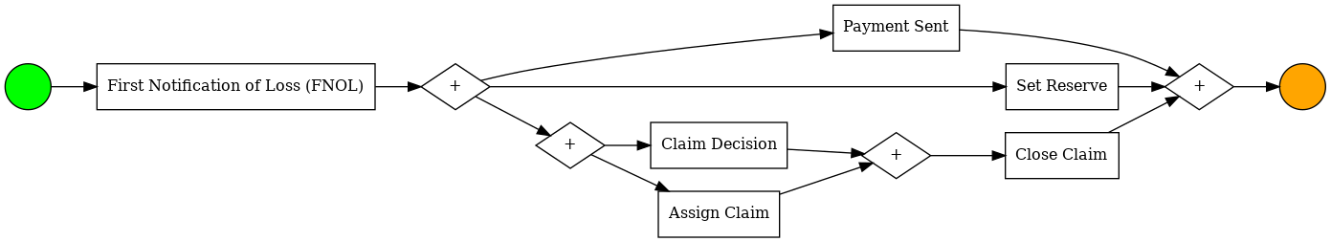
SAMPLE BPMN MODEL

Slide 43
4. Models in Process Mining
BPMN Components:
Artifacts: Additional information that provides more context, such as data objects, groups, and annotations.
Usage:
BPMN is used to create detailed, standardized diagrams of business processes that are easy to understand for both technical and non-technical stakeholders. It is commonly used for process improvement and automation projects.

Slide 44
4. Models in Process Mining
Model Discovery Algorithms
Alpha Algorithm:
Definition: The Alpha algorithm is one of the earliest process discovery algorithms. It constructs a Petri net based on the direct succession, causality, and concurrency relations between activities.
Strengths: Simple and easy to understand.
Limitations: Sensitive to noise and incomplete logs, struggles with complex and real-world processes.
Heuristics Miner:
Definition: Heuristics Miner is a process discovery algorithm that focuses on the most frequent behavior in the event logs, making it more robust to noise and exceptions.
Strengths: Handles noise better than the Alpha algorithm, provides heuristic nets that are easier to understand.
Limitations: May oversimplify the process by focusing only on frequent patterns, potentially missing less common but important behaviors.
Inductive Miner:
Definition: Inductive Miner is a process discovery algorithm that creates process models based on a divide-and-conquer strategy. It recursively decomposes the event log and constructs a process model that can handle various complexities.
Strengths: Produces sound process models (i.e., models that do not have deadlocks or other anomalies), can handle complex and large event logs effectively.
Limitations: More computationally intensive compared to simpler algorithms.

Slide 45
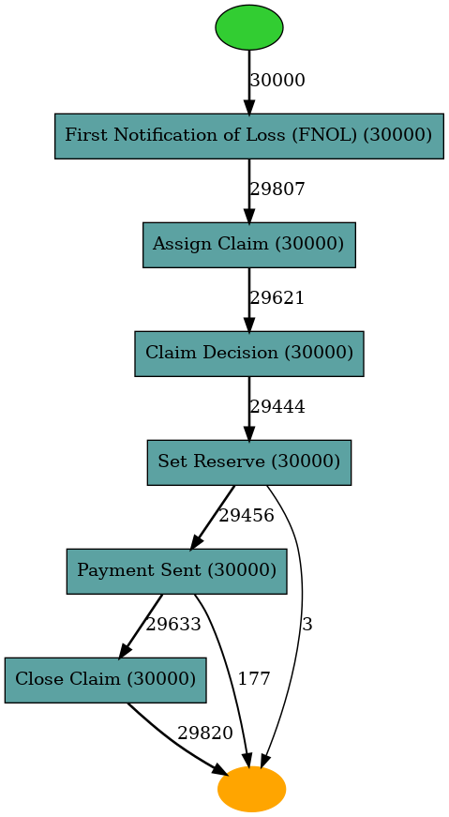
4. MODELS
SAMPLE DISCOVERY WITH HEURISTICS MINER

Slide 46
Process optimization

Slide 47
5. Process Optimization
Metrics for process performance
Throughput Time:
Definition: The total time taken for a process instance to complete from start to finish.
Importance: Indicates the efficiency of the process; shorter throughput times often imply a more efficient process.
Calculation: Throughput Time = End Time - Start Time
Cycle Time:
Definition: The time taken to complete one cycle of the process or one iteration of a repeated activity.
Importance: Helps in understanding the time required for each part of the process and identifying bottlenecks.
Calculation: Cycle Time = Sum of (Activity End Time - Activity Start Time) for all activities in the cycle

Slide 48
5. Process Optimization
Waiting Time:
Definition: The time that a process instance spends waiting for an activity to start.
Importance: High waiting times can indicate inefficiencies and areas where process flow can be improved.
Calculation: Waiting Time = Sum of (Activity Start Time - Previous Activity End Time)
4. Processing Time:
Definition: The actual time spent performing the activities in a process instance.
Importance: Reflects the active work time, excluding any waiting periods.
Calculation: Processing Time = Sum of (Activity End Time - Activity Start Time)
Lead Time:
Definition: The total time taken from the receipt of a request until its fulfillment.
Importance: Essential for understanding customer satisfaction and overall process responsiveness.
Calculation: Lead Time = Completion Time - Request Time

Slide 49
5. Process Optimization
Resource Utilization:
Definition: The extent to which resources (e.g., employees, machines) are used during the process.
Importance: Helps in identifying overutilized or underutilized resources, aiding in balancing workloads.
Calculation: Resource Utilization = (Total Time Resource is Active / Total Available Time) * 100%
First Pass Yield (FPY):
Definition: The percentage of process instances that are completed correctly without any rework or errors.
Importance: High FPY indicates a high-quality process with minimal defects.
Calculation: FPY = (Number of Instances Completed Correctly on First Attempt / Total Number of Instances) * 100%

Slide 50
5. Process Optimization
Rework Rate:
Definition: The proportion of process instances that require rework due to errors or defects.
Importance: Indicates process quality and areas where improvements are needed to reduce errors.
Calculation: Rework Rate = (Number of Instances Requiring Rework / Total Number of Instances) * 100%
Cost Efficiency:
Definition: The cost incurred in completing a process instance relative to the output generated.
Importance: Critical for understanding the economic efficiency of the process.
Calculation: Cost Efficiency = Total Cost / Total Output
Customer Satisfaction:
Definition: A measure of how well the process meets customer expectations and requirements.
Importance: High customer satisfaction is a key indicator of process success and overall business performance.
Calculation: Often measured through surveys and feedback scores.

Slide 51
5. Process Optimization
Steps for Process Optimization
Identify Performance Metrics: Choose relevant metrics based on the process goals and objectives.
Collect Data: Gather data from event logs, process monitoring tools, and other sources to measure the chosen metrics.
Analyze Performance: Use statistical and analytical methods to assess current process performance and identify bottlenecks, inefficiencies, and areas for improvement.
Implement Improvements: Develop and implement strategies to address identified issues, such as streamlining activities, reallocating resources, and eliminating bottlenecks.
Monitor Changes: Continuously monitor the process to ensure that the implemented improvements are effective and make further adjustments as necessary.
Iterate: Repeat the analysis and optimization cycle regularly to maintain and enhance process performance over time.

Slide 52
5. Process optimization
Bottleneck analysis
1. Identifying Bottlenecks:
Definition: A bottleneck is a stage in a process that reduces the overall capacity of the system due to its limited throughput.
Methods for Identification:
Process Mapping: Visualize the process using flowcharts, BPMN diagrams, or other modeling techniques to identify stages with delays or backlogs.
Performance Metrics: Analyze metrics such as throughput time, cycle time, and waiting time to spot stages with excessive delays.
Resource Utilization: Monitor the utilization of resources to identify overused or underused resources, indicating potential bottlenecks.
Queue Analysis: Examine the length and duration of queues at different stages to identify where work accumulates

Slide 53
5. Process Optimization
Bottleneck Analysis
2. Analyzing the Impact
Throughput Time: Determine how the bottleneck affects the overall time taken to complete the process.
Cost: Evaluate the financial impact of the bottleneck, including potential losses due to delays.
Quality: Assess how the bottleneck influences the quality of outputs, such as increased errors or reduced customer satisfaction.
Resource Allocation: Understand how the bottleneck affects resource distribution and efficiency.

Slide 54
5. Process Optimization
Bottleneck Analysis
3. Root Cause Analysis:
Data Analysis: Use data from event logs and performance metrics to pinpoint the exact cause of the bottleneck.
Interviews and Observations: Gather insights from process participants to understand practical challenges and constraints.
Fishbone Diagrams: Create cause-and-effect diagrams to systematically identify potential causes of the bottleneck.
Remove Unnecessary Steps: Eliminate redundant or non-value-added activities to reduce delays.
Simplify Workflow: Redesign the process to minimize complexity and improve flow.

Slide 55
5. Process Optimization
Process Improvement Strategies
Streamlining Processes:
Remove Unnecessary Steps: Eliminate redundant or non-value-added activities to reduce delays.
Simplify Workflow: Redesign the process to minimize complexity and improve flow.
2. Resource Optimization:
Reallocate Resources: Shift resources from underutilized areas to the bottleneck stage to balance workloads.
Cross-Training: Train employees to handle multiple tasks, increasing flexibility and reducing dependency on specific individuals.

Slide 56
5. Process Optimization
3. Technology and Automation:
Implement Automation: Use automation tools to handle repetitive tasks, reducing manual effort and speeding up the process.
Upgrade Systems: Invest in technology upgrades to improve processing speed and efficiency.
4. Process Redesign:
Parallel Processing: Redesign the process to allow multiple activities to occur simultaneously rather than sequentially.
Decentralization: Distribute tasks across different teams or locations to avoid overloading a single point.
5. Performance Monitoring:
Continuous Monitoring: Use real-time monitoring tools to track process performance and detect emerging bottlenecks promptly.
Feedback Loops: Establish regular feedback mechanisms to gather insights from process participants and adjust strategies accordingly.

Slide 57
5. Process Optimization
6. Capacity Expansion:
Increase Capacity: Add more resources, such as personnel or equipment, to the bottleneck stage to boost throughput.
Flexible Work Schedules: Implement flexible work hours or shifts to increase the effective capacity without hiring additional staff.
7. Lean Methodologies:
Kaizen (Continuous Improvement): Foster a culture of continuous improvement where small, incremental changes are regularly made to improve the process.
Six Sigma: Apply Six Sigma techniques to systematically reduce variability and defects, improving overall process performance.
8. Process Standardization:
Standard Operating Procedures (SOPs): Develop and implement SOPs to ensure consistency and efficiency in task execution.
Best Practices: Identify and adopt industry best practices to enhance process efficiency and effectiveness.

Slide 58
Software tools

Slide 59
6. Software tools
THINGS TO CONSIDER WHEN CHOOSING SOFTWARE
Capability | Benefit
Connects with All Data | Can bring data together, in real time, from all of the necessary sources that will together create a complete picture of your processes
Ingests Data | Critical prerequisites are data preparation, cleaning, and transformation.
Has Prebuilt Connectors | .
Supports Task Mining | Captures processes that take place outside of transactional IT systems
Supports Automation | You want to remove the need for human actions and replace them with automated fixes and activities. By combining process mining with automation, you’re able to directly correct process inefficiencies
Integrates with Existing Tools | integrated with your existing technologies such as business intelligence (BI), business process management (BPM), integration platform as a service (iPaaS), and robotic process automation (RPA).

Slide 60
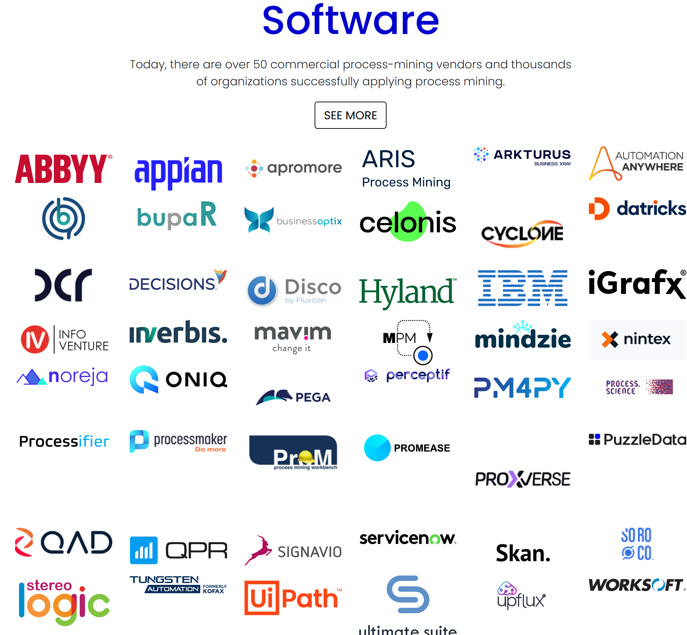
6. Software tools
Some top process mining software companies include:
•Celonis
•UiPath Process Mining
•SAP Signavio Process Intelligence
•Appian
•Apromore
•Scout Platform
•ARIS
Notes:
According to processmining.org there over 50 commercial software solutions for process mining.

Slide 61

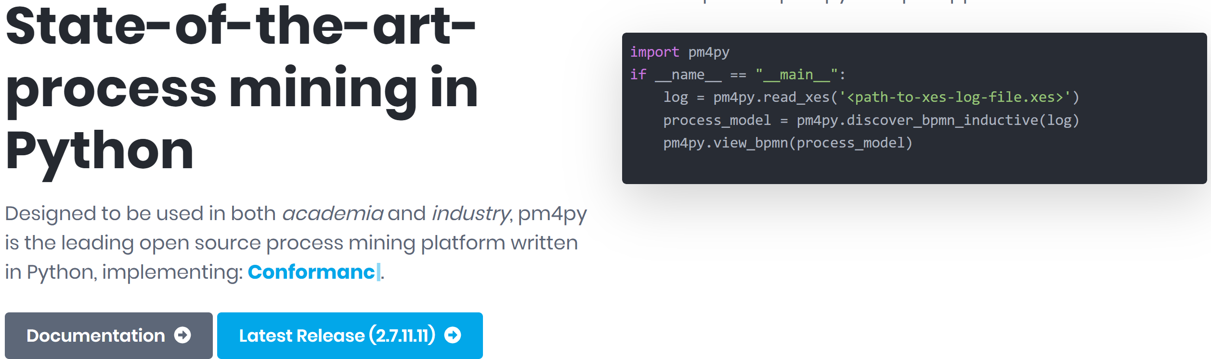
6. SOFTWARE TOOLS
Link
https://pm4py.fit.fraunhofer.de/ -

Slide 62
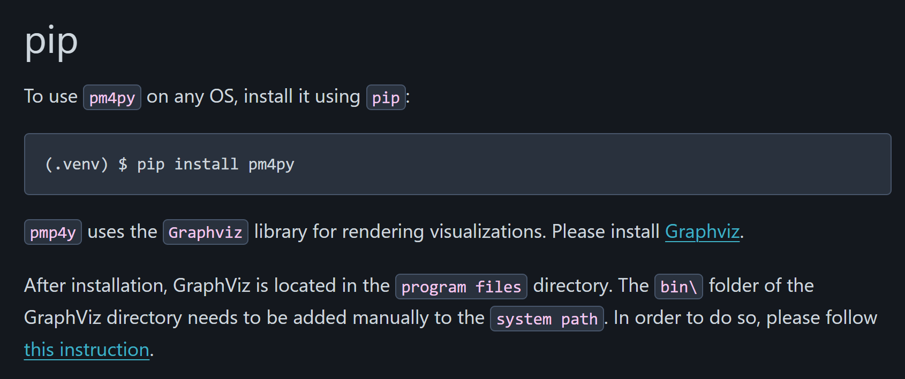
6. Software tools
Install pm4py and graphviz using pip
graphviz

Slide 63
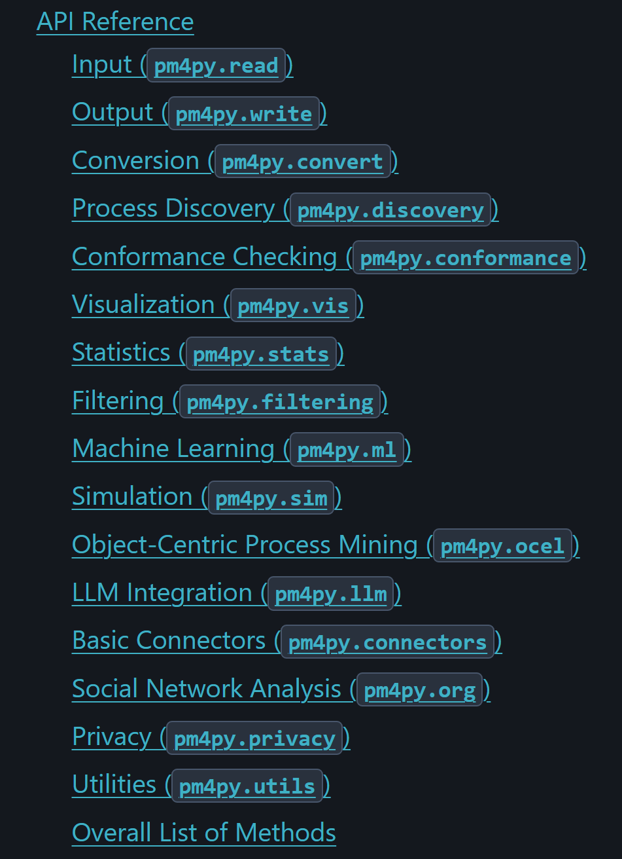
6. Software tools
Capabilities of pm4py
Notes:
LLM integration means we can use ChatGPT to explain our visualizations

Slide 64
6. Software tools
PM4PY supports tabular data input like CSV with the help of pandas.
The recommended data format for event logs is XES
XES stands for EXtensible Event Stream.
XES is an XML based hierarchical, tag-based log storage format prescribed by IEEE as a standard.
All algorithms implemented in pm4py assume that we have already extracted the event data into an appropriate event log format. Hence, the core of pm4py does not support any data extraction features.

Slide 65
Python (Pm4py) exercises

Slide 66
6. Software tools
Dataset Description:
Link: https://www.kaggle.com/datasets/carlosalvite/car-insurance-claims-event-log-for-process-mining
This event log has been artificially generated and curated to provide a comprehensive view of car insurance claims, allowing users to discover and identify bottlenecks, automation opportunities, conformance issues, reworks, and potential fraudulent cases using any process mining software.
You can find more event logs here: https://processminingdata.com/

Slide 67
6. Software tools
Objective:
To gain insights into how insurance claims were processed. In particular, to reduce the lengthy claims processing time of claims.
What are the key differences in the way claims were processed between claims that completed on-time and those that did not?
Metrics to consider:
The throughtput time is the total time from the creation of the case to the completion of the case.
The service time is the time worked on a case. The service time per activity can be measured. In the case of concurrency, the overall service time may be longer than the lead time.
The waiting time is the time a case is waiting for a resource to become available.

Slide 68
Insurance claim PROCESS BREAKDOWN
1. First Notification of Loss (FNOL): This is the initial report of an incident or loss. It's the first step in the claims process, where the insured party notifies the insurance company about the event (e.g., an accident, etc.).
5. Payment Sent: After assessing the claim, the insurance company determines the amount to be paid to the policyholder. If the claim is approved, they send the payment.
4. Set Reserve: Insurance companies set aside a reserve fund for each claim. This reserve covers the estimated cost of the claim until it's fully settled. Adjusters continuously update the reserve based on new information.
3. Claim Decision: This step involves evaluating the claim, verifying details, and deciding whether to approve or deny it. Factors like policy coverage, evidence, and policy terms play a role in this decision.
2. Assign Claim: The claim is assigned to a claims adjuster. The adjuster investigates further, communicates with the insured, and manages the claim process.
6. Close Claim: After all necessary steps are completed (including payment), the claim is officially closed. This means the insured has received compensation, repairs are done, or the case is resolved.
Notes:
6 events per case

Slide 69
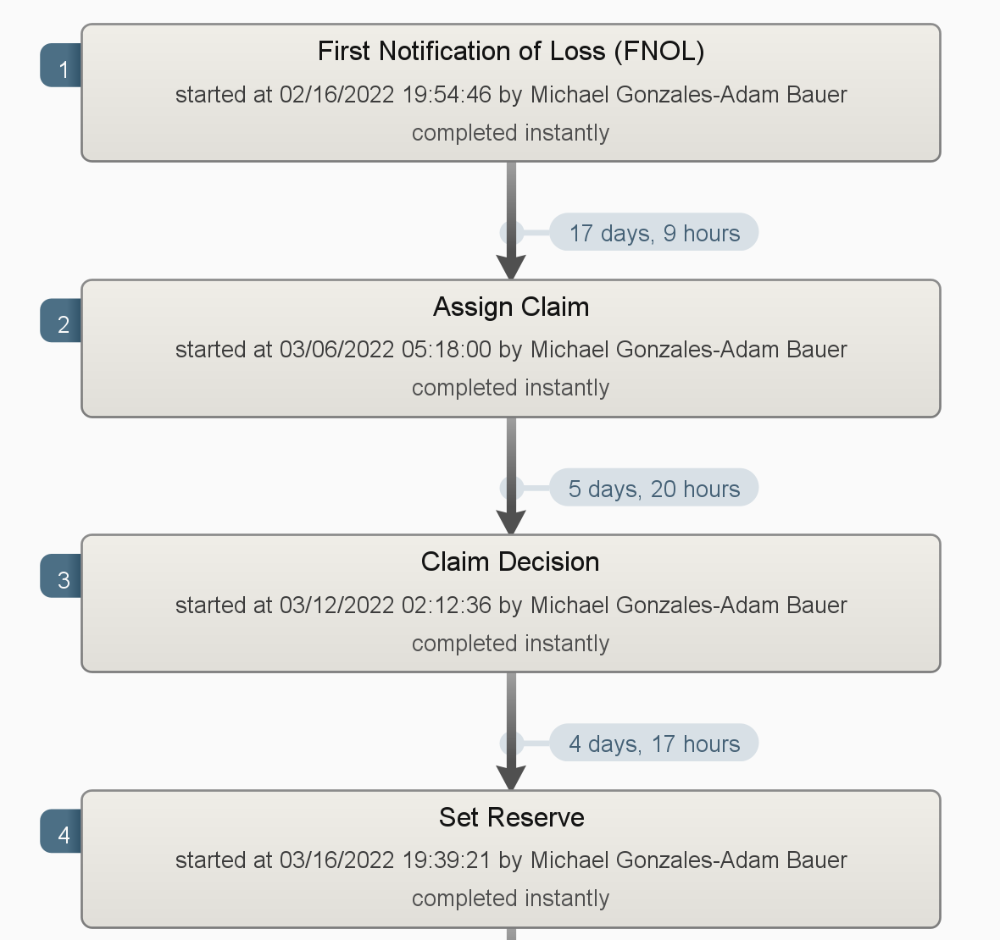
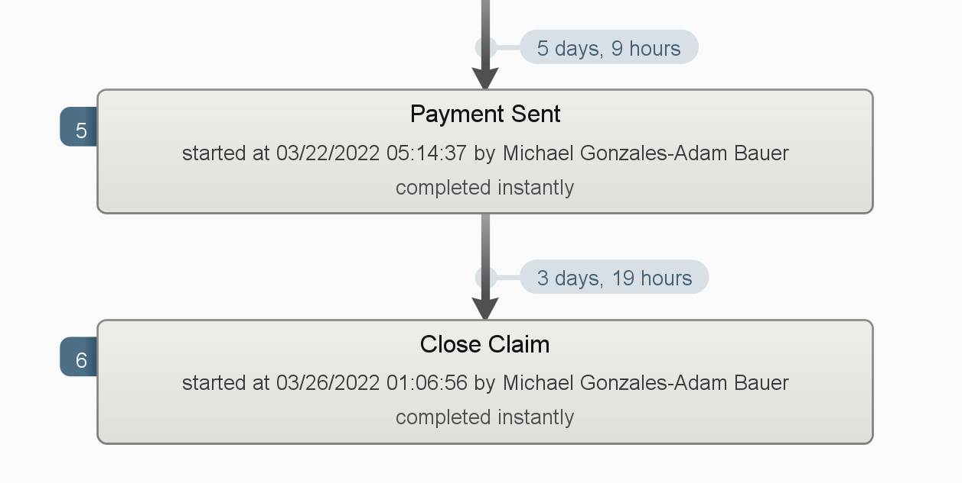
Sample case from the log
Here we can see the timestamp, agent and adjuster information enriching the flow diagram
This claim took 35 days and 5 hours to process.

Slide 70
6. Software tools
Exercise 1: Introduction to Event Logs
Objective: Understand the structure of event logs and how to preprocess them.
Tool: Pm4py
Tasks:
Import a sample event log.
Clean and preprocess the event log (e.g., remove duplicates, handle missing values).
Visualize basic statistics of the event log (e.g., number of events, cases, and activities).

Slide 71
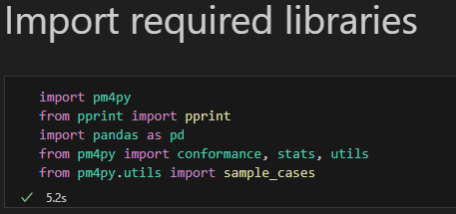
6. SOFTWARE TOOLS
We import the necessary libraries that are needed to conduct process mining.

Slide 72
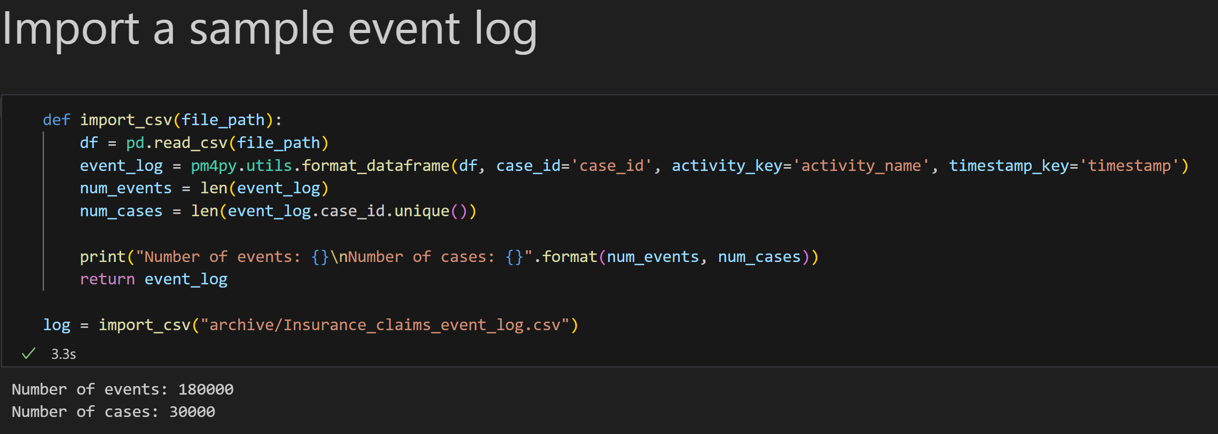
6. SOFTWARE TOOLS
NB: This event log can be reused in all exercises

Slide 73
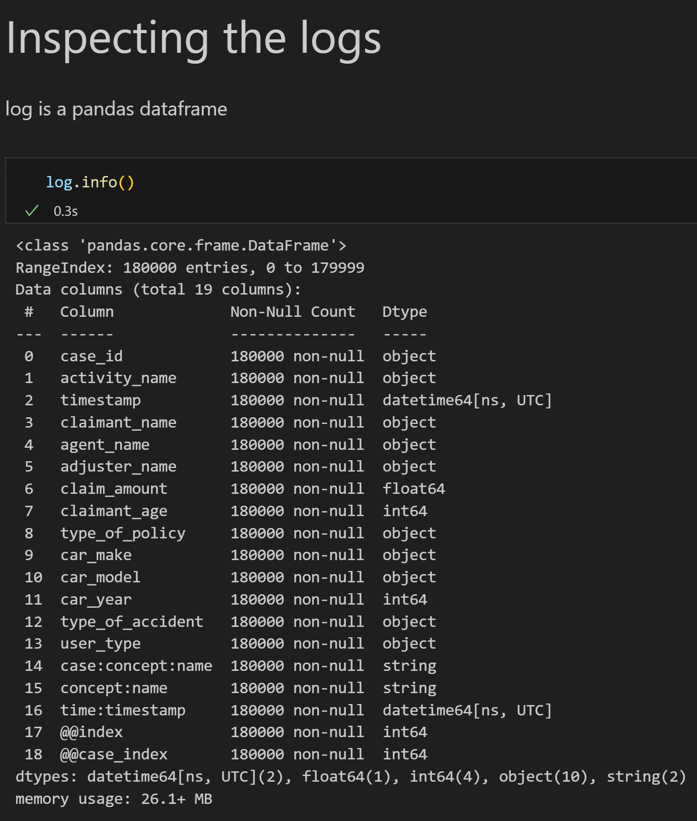
OUTPUT
A look at the columns, their data types, and completeness.
Incorporating extra data attributes can enhance the precision of case and event analysis.
Furthermore, these extra attributes may hold crucial contextual details that can be leveraged to deepen the understanding of the process.

Slide 74
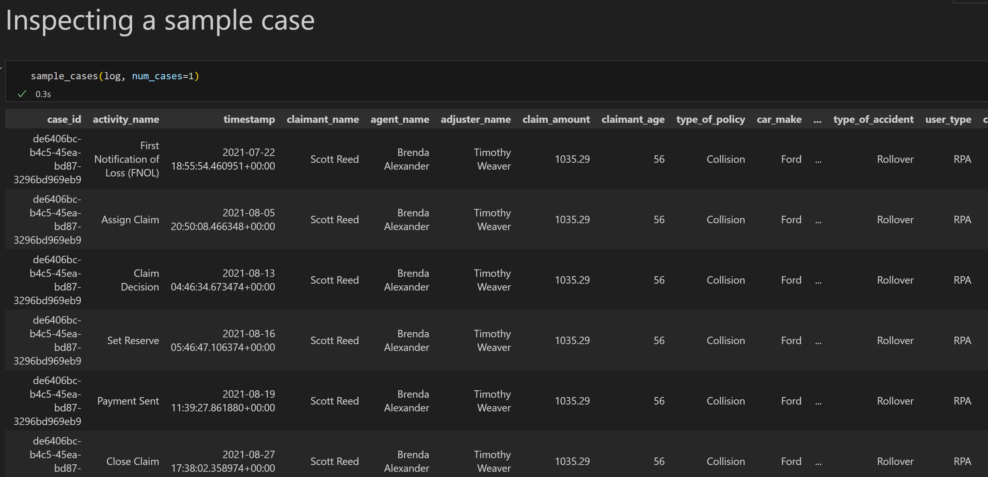
6. Software tools

Slide 75
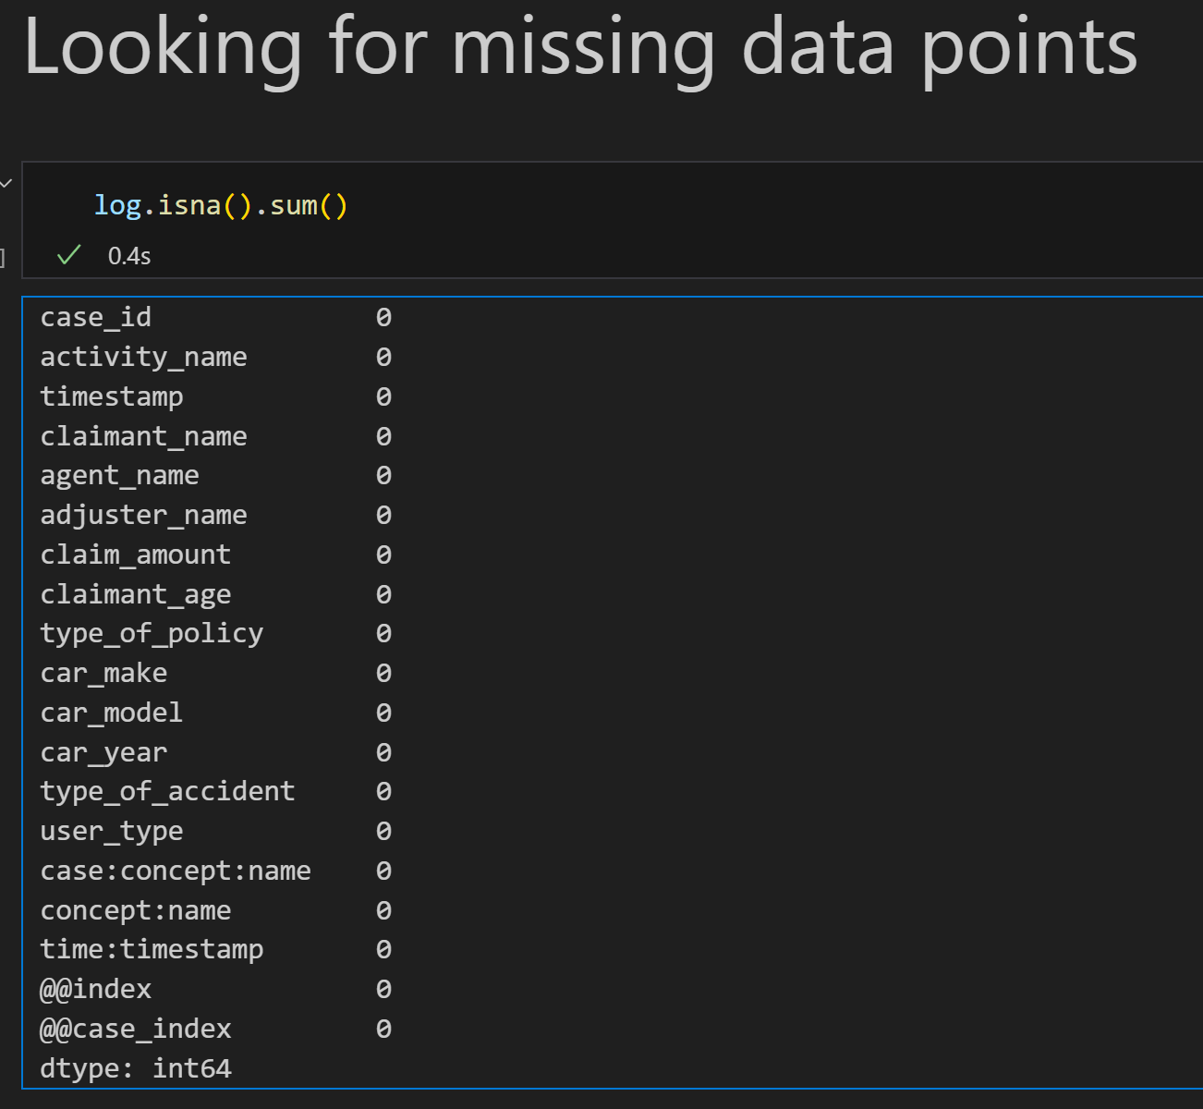
6. Software tools
At least for this event log, there are no missing data points or duplicates

Slide 76
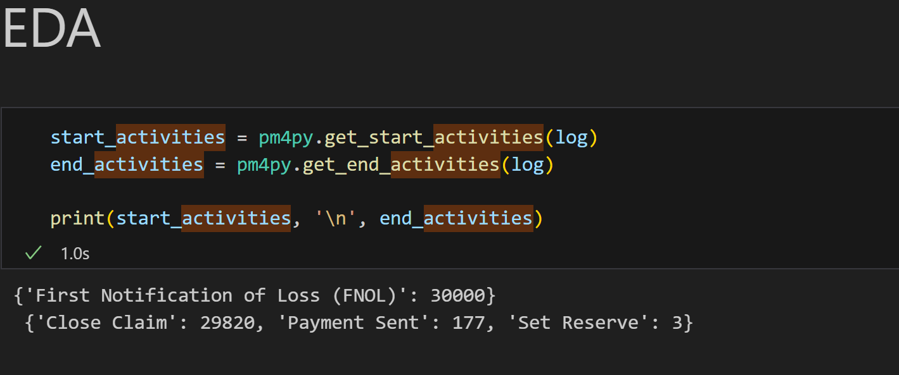
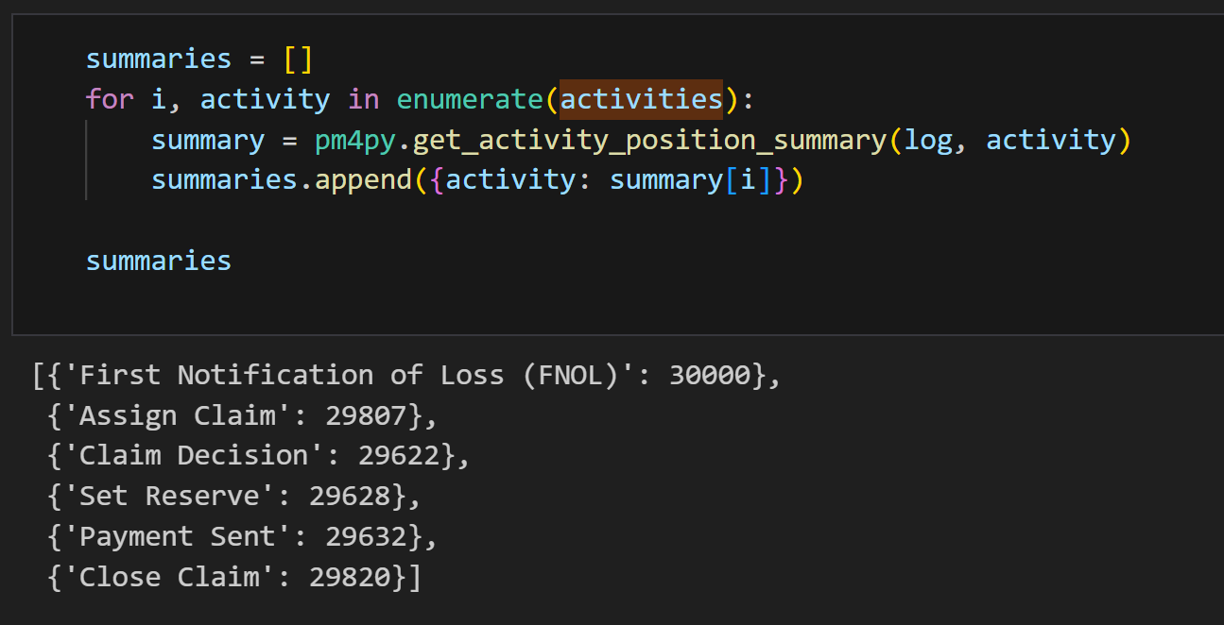
6. Software tools
SUMMARY:
The insurance company is notified of a loss by the client.
Eventually, claims may be closed, paid out, or set on reserve. Some activities may be skipped.

Slide 77
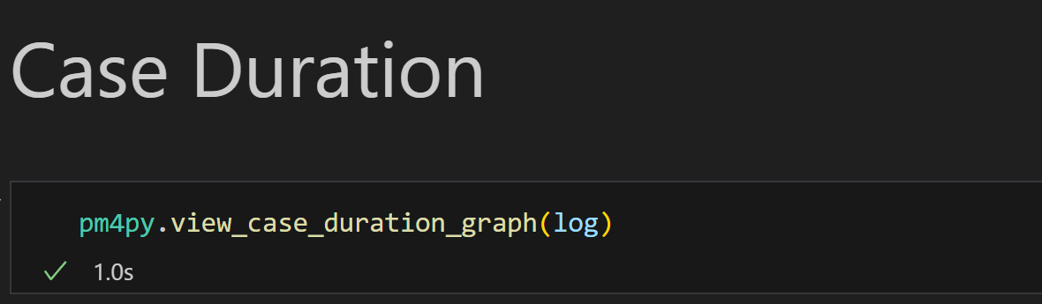
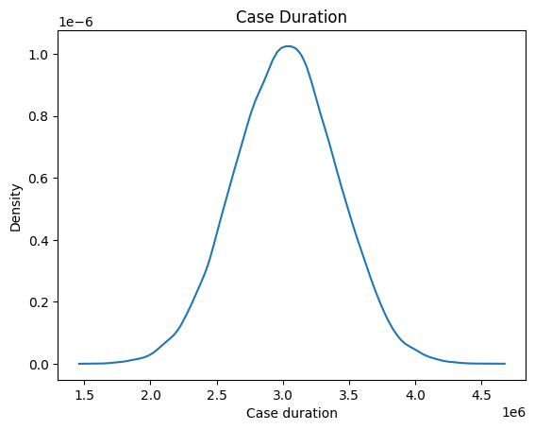
Case duration graph
Shows the duration of cases over time. It helps to identify patterns, such as bottlenecks or inefficiencies, within a process by displaying the time taken for each case from start to end.
This type of graph can be particularly useful for analyzing the performance of business processes and for identifying opportunities for optimization.

Slide 78
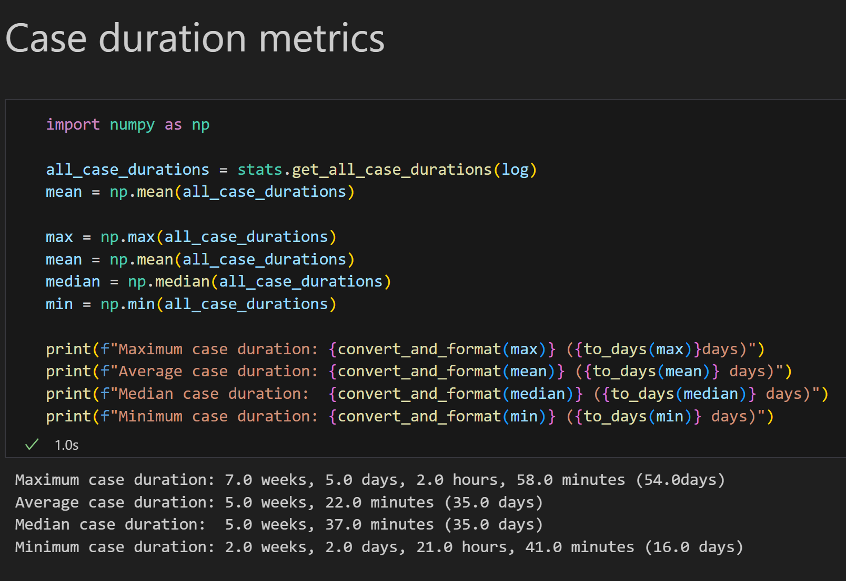
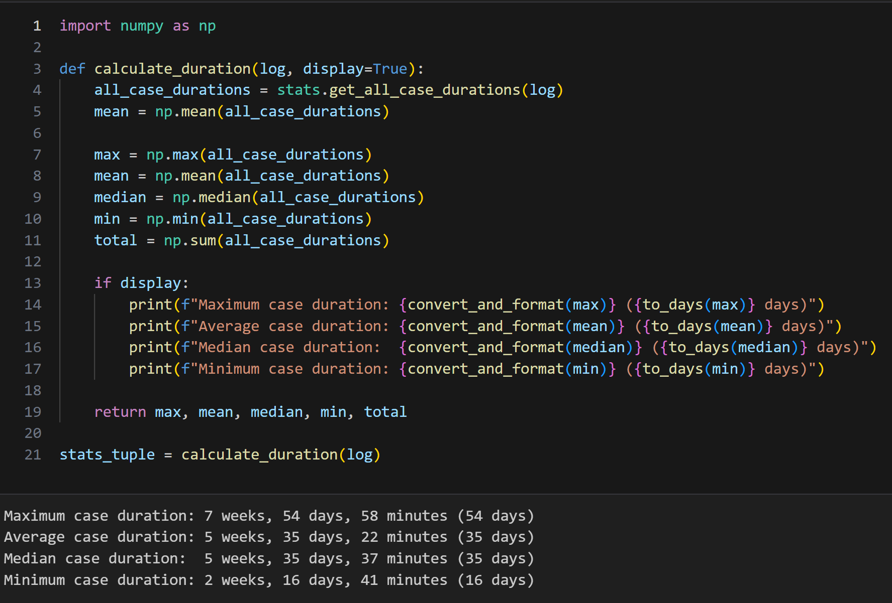
Throughput time

Slide 79
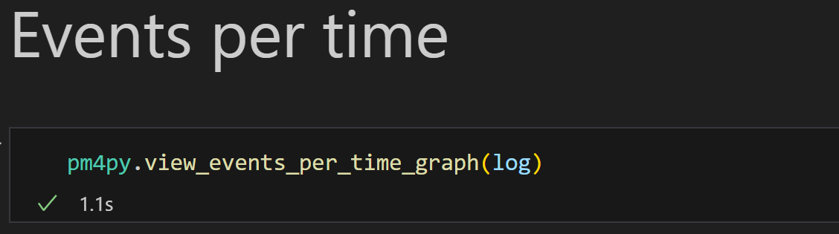
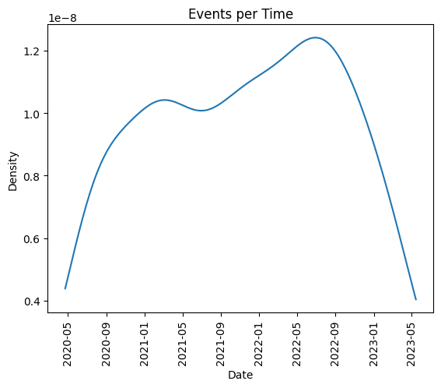
Events per time graph

Slide 80
6. Software tools
Exercise 2: Process Discovery with Alpha Algorithm
Objective: Discover process models using the Alpha algorithm.
Tool: PM4PY
Tasks:
Import a cleaned event log.
Apply the Alpha algorithm to discover the process model.
Visualize and analyze the discovered process model.

Slide 81
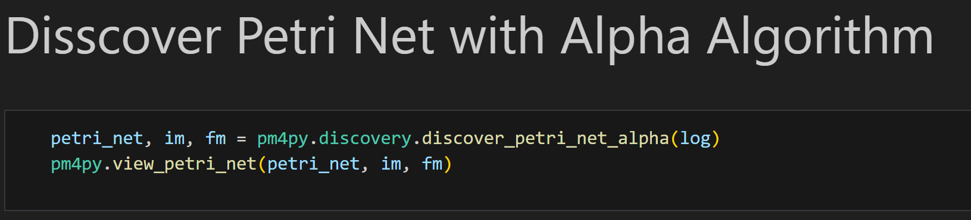
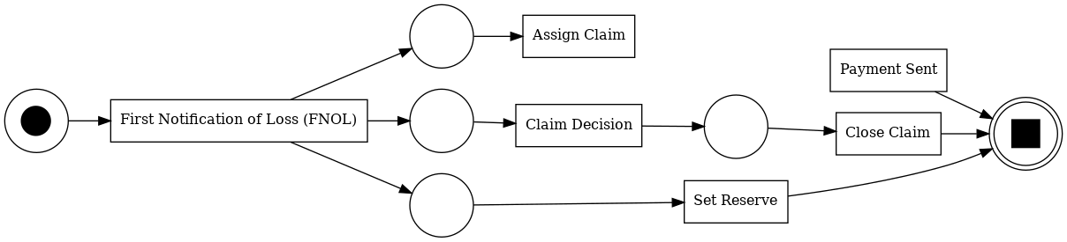
6. Software tools
Notes:
This function returns a petri net, initial marking, and final marking. They will be useful later for other algorithms.

Slide 82
6. Software tools
Exercise 3: Conformance Checking
Objective: Compare discovered process models with existing models to check for conformance.
Tool: Pm4py
Tasks:
Import a discovered process model and a reference model.
Perform conformance checking using token-based replay.
Analyze deviations and generate conformance metrics.

Slide 83
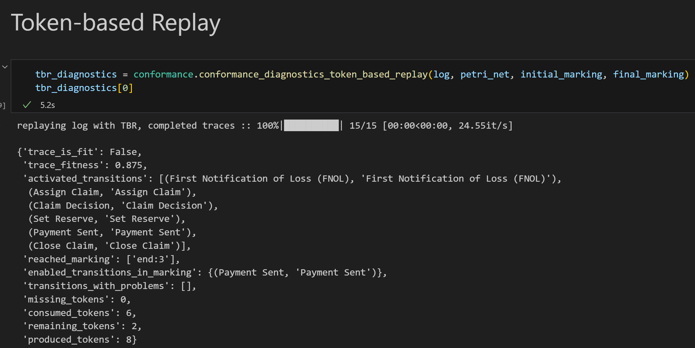
Conformance checking with TBR
Notes:
We pass in our prior petri net, initial and final markings as arguments to the TBR function.

Slide 84
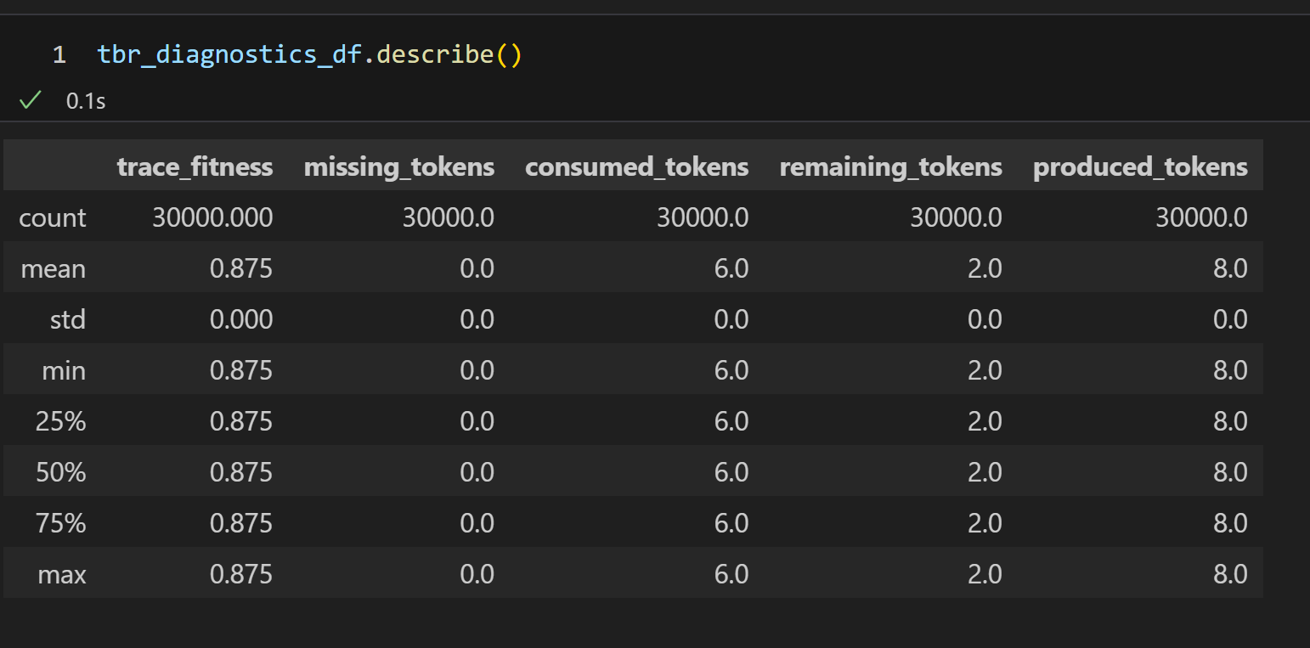
Conformance checking with TBR
No traces perfectly fit the process model. However, there is a significant fitness of 87.5%
Notes:
We pass in our prior petri net, initial and final markings as arguments to the TBR function.

Slide 85
6. Software tools
Exercise 4: Bottleneck Analysis
Objective: Identify and analyze bottlenecks in a process.
Tool: Pm4py, Disco
Tasks:
Import a sample event log.
Visualize the process and identify stages with high waiting times.
Analyze the impact of bottlenecks on overall process performance.

Slide 86
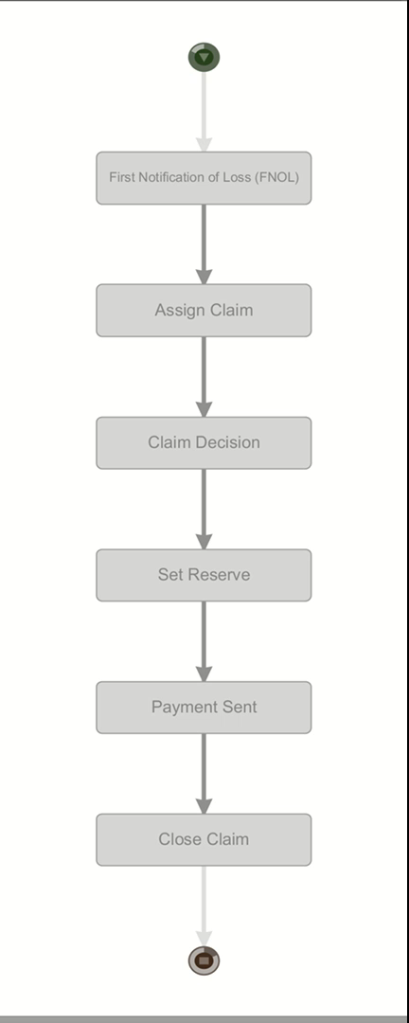
Insurance process animation
The process is visualized, and we can see the bottlenecks.
There are high waiting times particularly in between FNOL and assigning a claim.
There is also some lag before arriving at a claim decision.
NB: This is a video, press play.

Slide 87
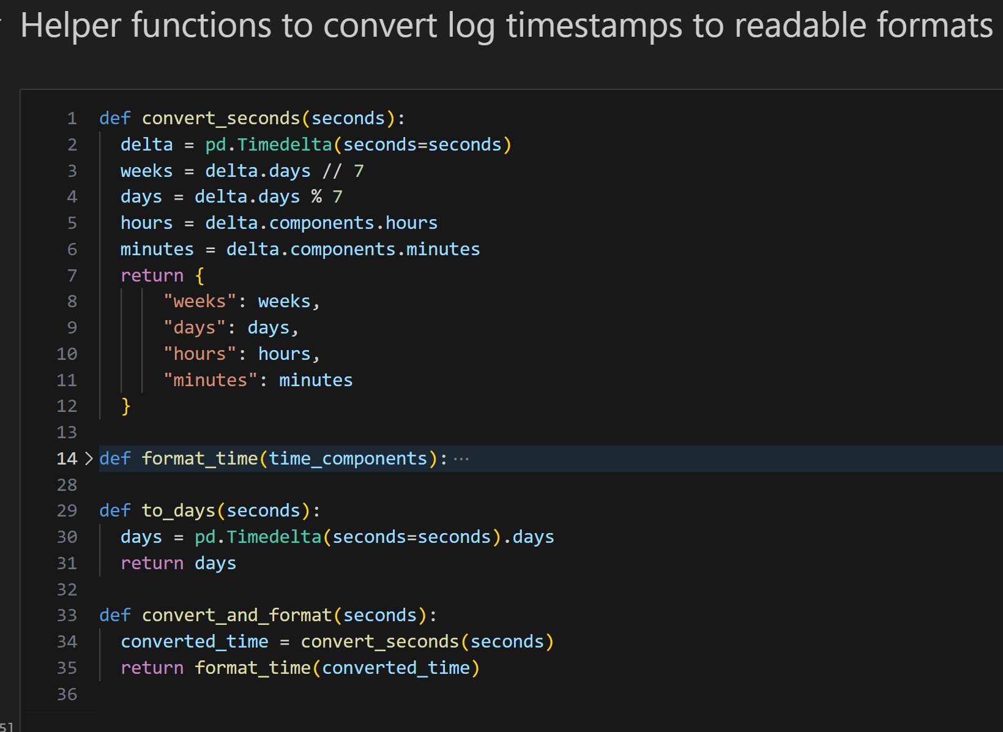
Pm4py timestamps
Timestamps are in seconds and need to be converted to a human readable format.
Any component of time that does not resolve to a complete unit of time is carried over.
E.g. 7 weeks, 1 day.

Slide 88
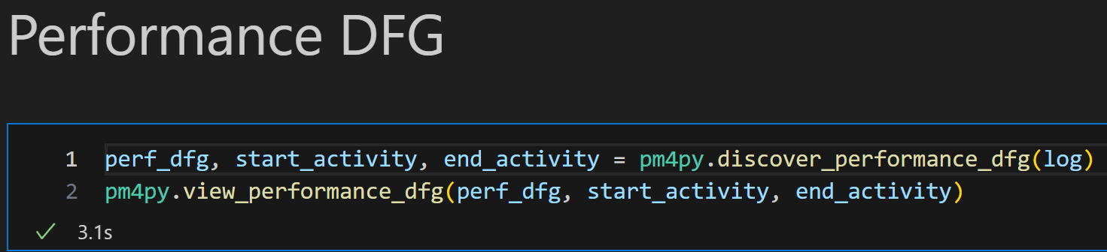
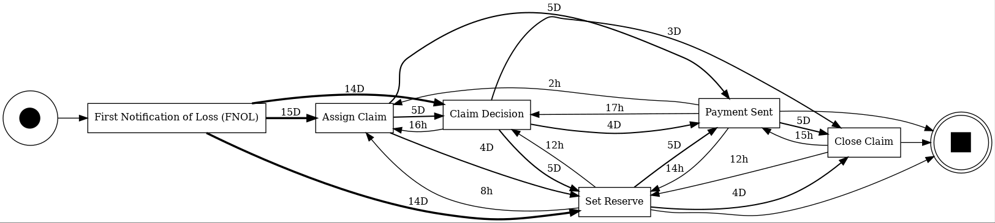
Enhancing DFG diagram with case duration

Slide 89
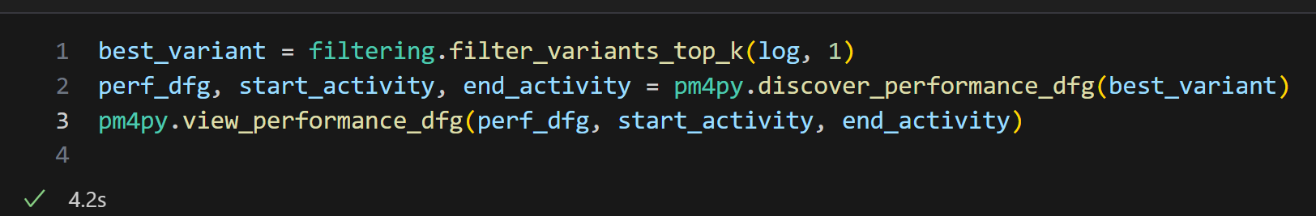
GETTING THE top VARIANT (by number of cases)

Slide 90
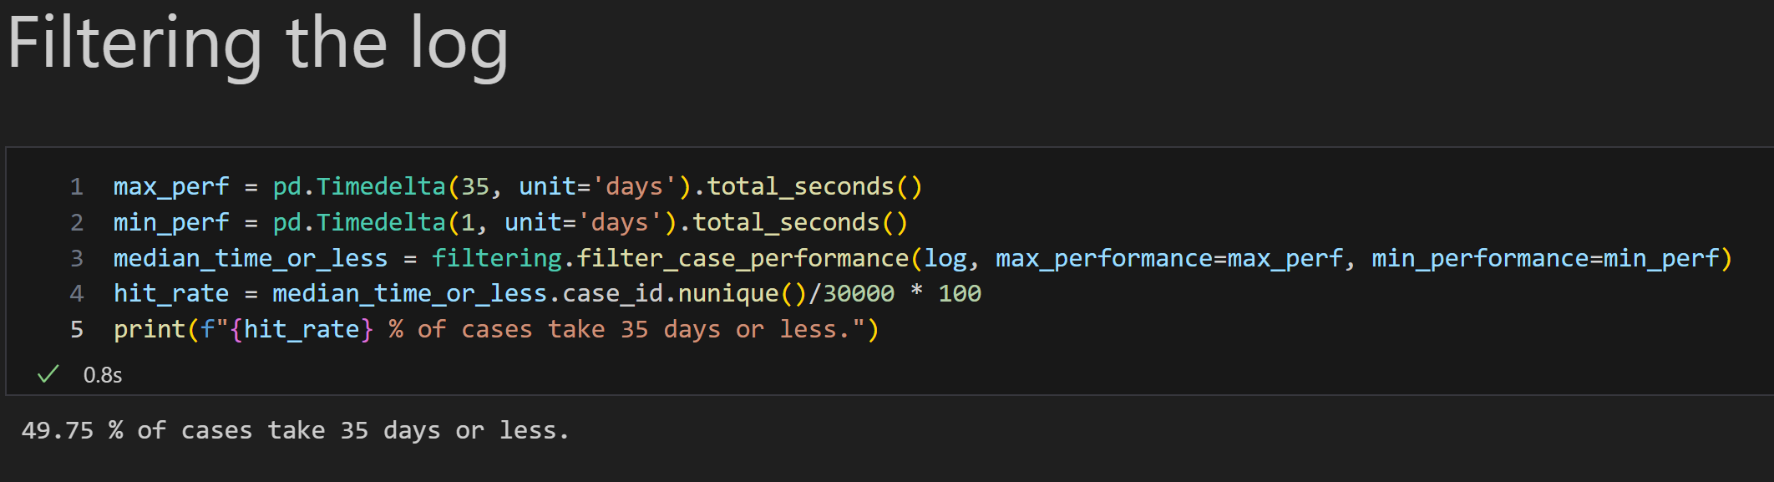
Getting cases that perform well

Slide 91
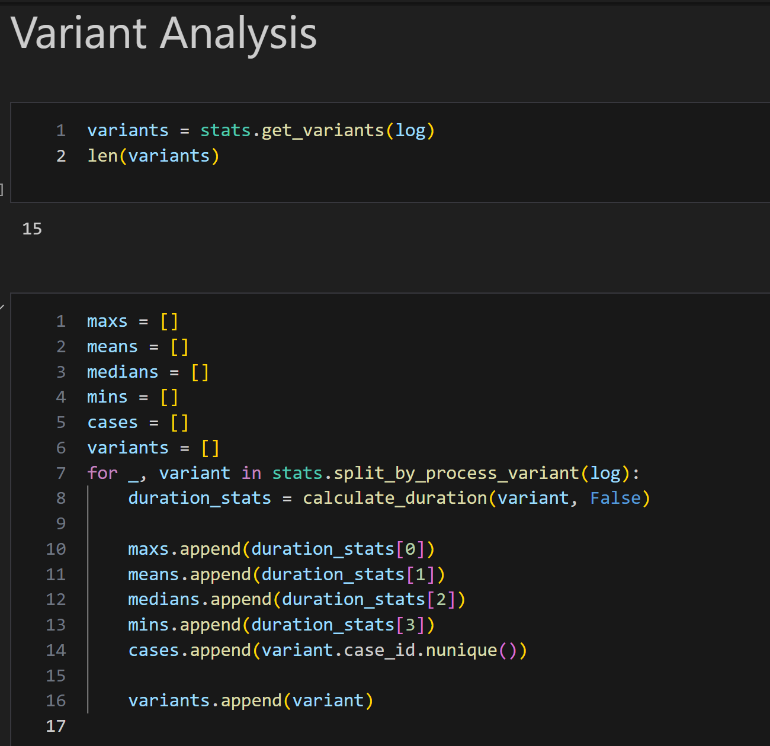
Understanding the process variants
There are 15 variants to this process. Meaning there are 15 distinct traces (sequence of activites).

Slide 92
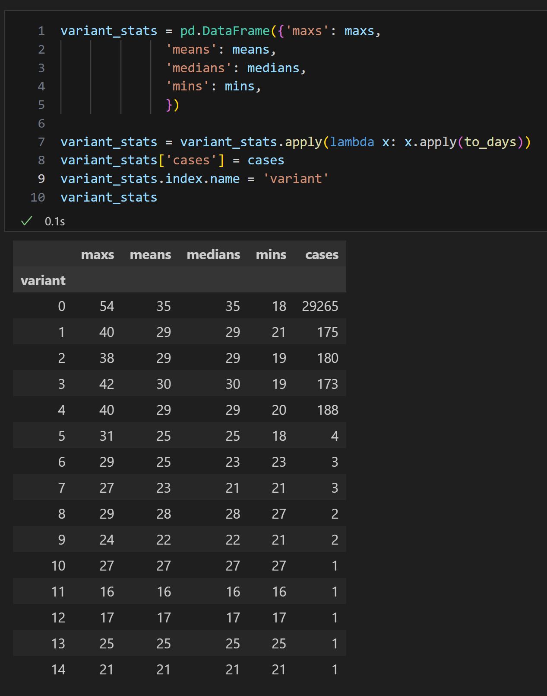
Understanding the process variants
The best performing variant takes only 16 days. However, this is only a single case. We can see that majority (29265) of the cases follow the variant 0 trace.
Variant 0 is outperformed by all the others as indicated by the measures of central tendency

Slide 93
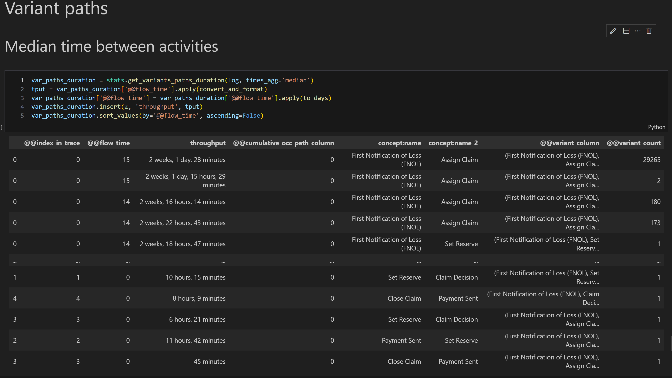
Breaking down trace segments: identifying the bottleneck
Notes:
As indicated before in the video, the hold up seems to be between FNOL and Assign Claim

Slide 94
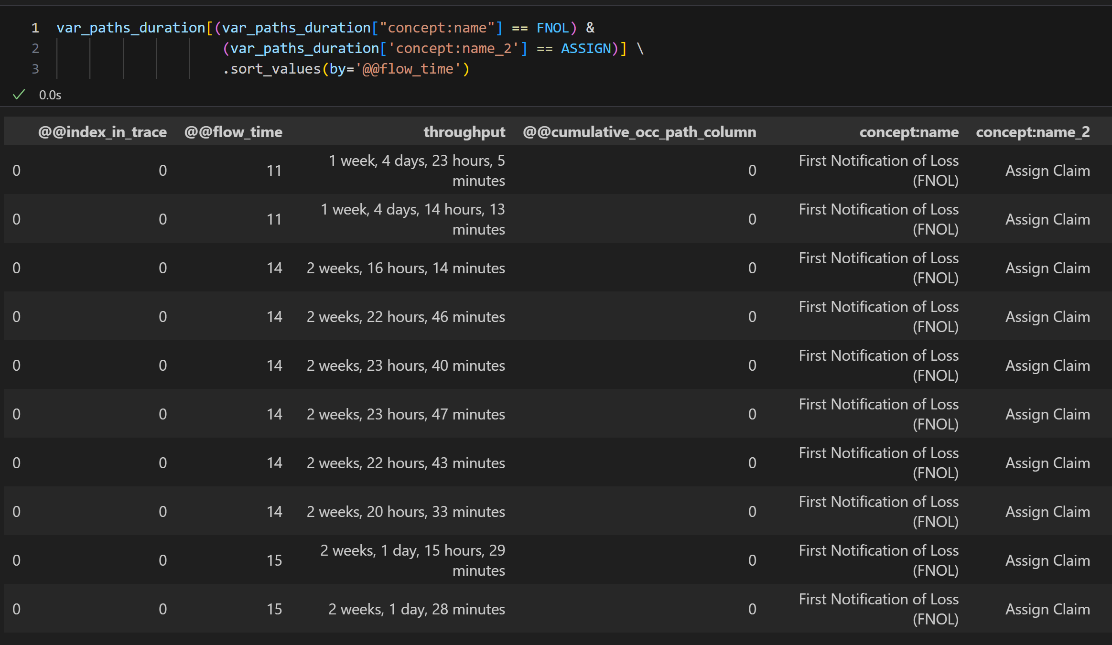
Breaking down trace segments: identifying the bottleneck
Assigning a claim can take as litte as 11 days.
Notes:
As indicated before in the video, the hold up seems to be between FNOL and Assign Claim

Slide 95
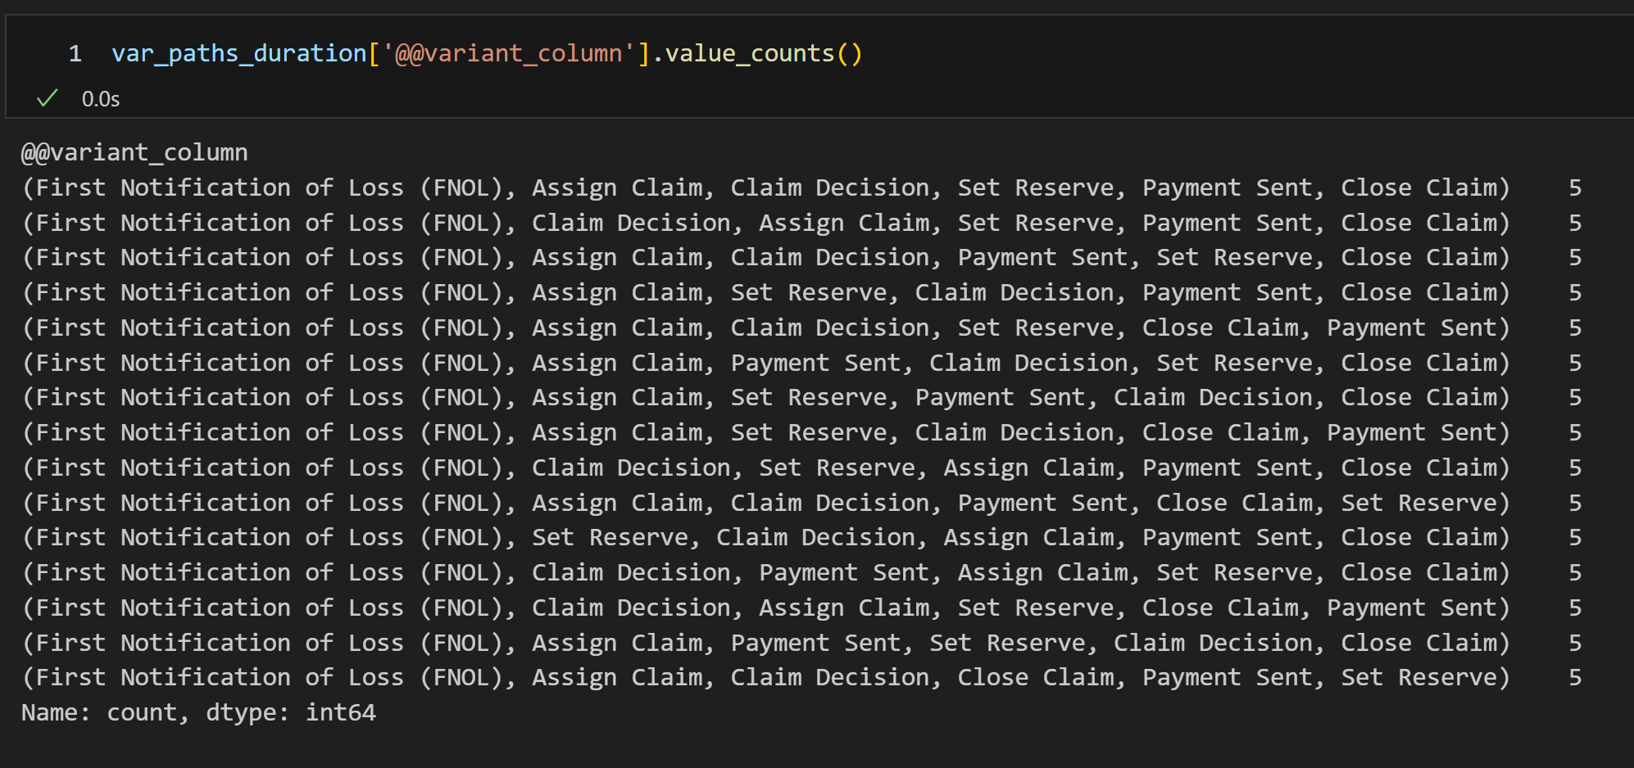
Actual trace for the 15 variants
The standard order of operations is not being followed.
E.g. a claim is being assigned after payment has already been made.

Slide 96
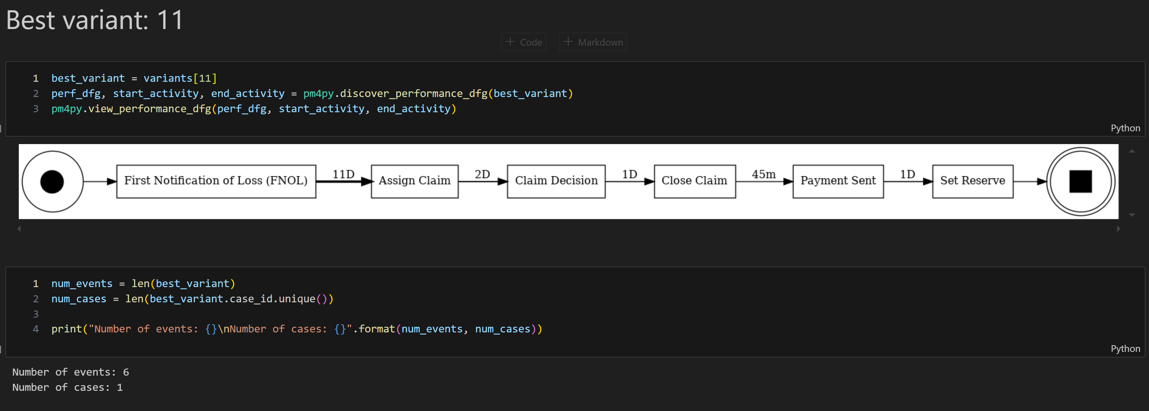
Inspecting the top variant

Slide 97
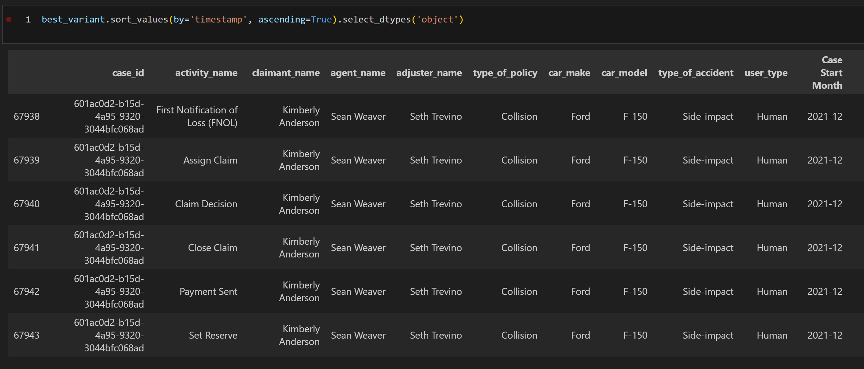
Inspecting the top variant event attributes

Slide 98
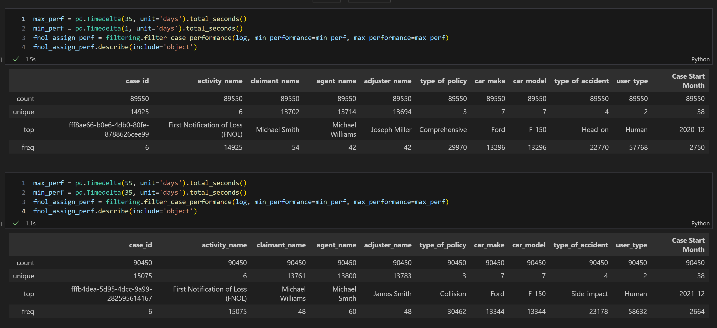
event attributes of top vs bottom 50%

Slide 99
6. Software tools
Exercise 5: Process Enhancement
Objective: Enhance a process model with performance data.
Tool: Pm4py
Tasks:
Import an event log and a discovered process model.
Enrich the process model with performance data (e.g., activity durations).
Visualize and analyze the performance-enhanced process model.

Slide 100
6. Software tools
Exercise 6: Resource Utilization Analysis
Objective: Analyze resource utilization in a process.
Tool: Pm4py
Tasks:
Import an event log with resource information.
Calculate and visualize resource utilization metrics.
Identify overutilized and underutilized resources.

Slide 101
6. Software tools
Exercise 7: Predictive Process Mining
Objective: Use historical data to predict future process behavior.
Tool: Celonis Snap (free version)
Tasks:
Import a sample event log.
Train a predictive model using historical event data.
Use the model to predict future process outcomes and identify potential issues.

Slide 102
6. Software tools
Exercise 8: Custom Process Mining Analysis
Objective: Perform a custom analysis based on a real-world event log.
Tool: Any preferred tool
Tasks:
Import a real-world event log.
Define a specific analysis goal (e.g., improving cycle time, reducing costs).
Apply relevant process mining techniques to achieve the goal.
Present findings and recommend improvements

